Slide 1
Virtual Memory Module 6
Operating Systems

Slide 2
Chapter Outline
Virtual memory
Mechanism of virtual memory
Address translation
Page fault
Page replacement
Page replacement algorithm
FIFO
Optimal LRU
Random page replacement
Least frequently used
Most frequently used
Non-used recently page replacement algorithm
Paging Mechanism
Additional techniques

Slide 3
Virtual Memory
Why we need virtual memory
The program size may exceed the amount of physical memory
The OS keeps those parts of the program currently in use in main memory and the rest on disk
The piece of the program being swapped between disk and memory as needed
Virtual memory can also work in a multiprogramming system

Slide 4
Virtual Memory
A technique that allows execution of a process without having to allocate it the memory space it needs, completely
It gives the idea that large memory is available at programmer’s disposal even computer has relatively small main memory
A program can be written assuming large address space is available
That is the virtual address space >> physical address space
The entire logical address space of a process must be in physical memory before the process can execute
First Implemented in Intel 80386

Slide 5
Virtual Memory
Advantages of virtual memory:
Programs can be larger than the size of the physical memory
Virtual memory accommodates them
Virtual memory provides a logical view of memory which is larger than its physical size
Virtual memory is not easy to implement
May substantially decrease performance if it is used carelessly
Virtual memory can be implemented via:
Paging
Segmentation

Slide 6
Virtual Memory
Demand Paging
In demand paging, bring a page into main memory only when it is needed
Less I/O needed
Less memory needed
Faster response
More users
Page is needed ➔ reference to it
Invalid reference → abort
Not in memory → bring to memory
It can also be implemented in a segmentation system
Demand Segmentation
Demand segmentation can also be used to provide virtual memory
Several systems provide paged segmentation scheme
Segments are broken into pages
The IBM OS/2 uses demand segmentation

Slide 7
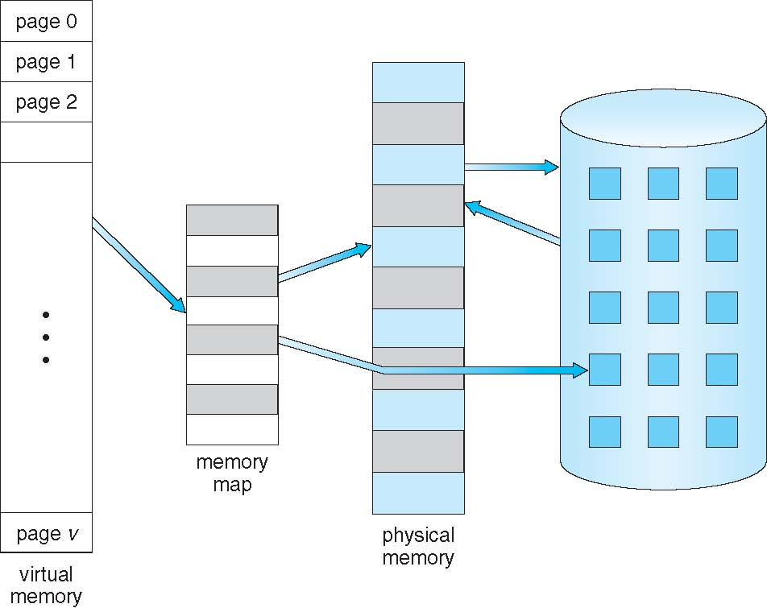
Virtual Memory
Virtual Memory is Larger Than Physical Memory

Slide 8
Mechanism of Virtual Memory
When a new process is initiated, the system loader must load one page (start point) into real memory
Execution of the process will commence
This will continue as long as memory references generated by this page also within the same page
If the virtual address generated will reference a page which is not in real memory; this is termed as page fault, which generates an interrupt
The demand paging will be used, and system loader will load the next demanded page
Execution will proceed after requested page is loaded
By a series of page faults occurring in this way, a sub-set (resident set) of the pages of a process will gradually accumulate in real memory
When the process terminates the OS releases all pages belonging to that process, making room for other processes

Slide 9
Mechanism of Virtual Memory
Additional techniques
Hardware techniques to improve performance of virtual paged system
Translation look aside buffer (TLB)
Associative mapping

Slide 10
Translation Look Aside Buffer
TLB (Translation Lookaside Buffer)
TLB is a small, fast cache that stores recent page table entries.
Key Points
Stores Virtual Page Number → Frame Number
Reduces page table access time
Implemented using associative memory
Part of the MMU (Memory Management Unit)
In Virtual Memory
Speeds up address translation
Avoids accessing main memory page table
Associative Memory is a hardware concept for fast searching
TLB is an OS structure that uses associative memory to speed up address translation

Slide 11
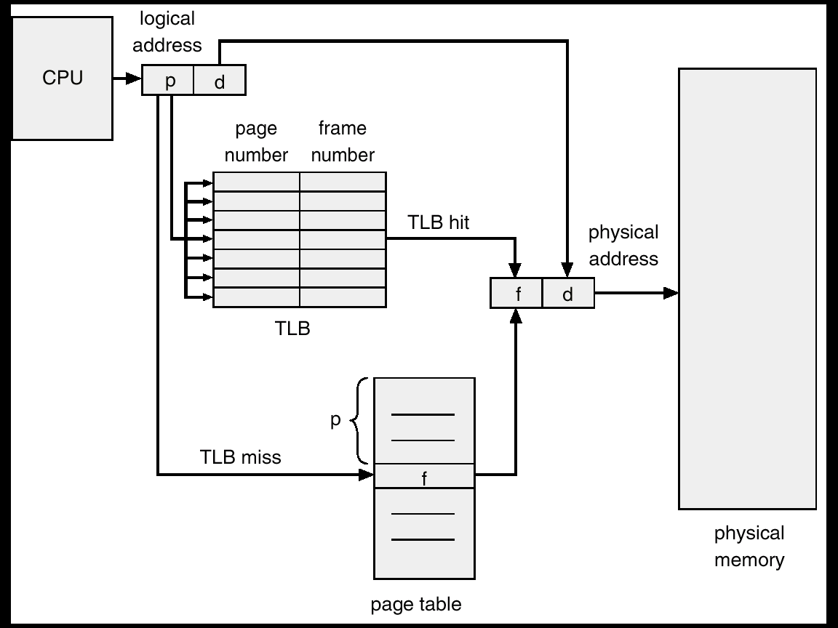
Translation Look Aside Buffer

Slide 12
Associative Mapping
Associative Memory is a hardware memory type that is accessed by content rather than address.
Key Points
Searches all entries in parallel
Returns a match based on content
Very fast, but expensive
Used where quick lookup is required
In Virtual Memory
Associative memory is the technology
TLB is implemented using associative memory
Example
If you search:
Virtual Page Number = 5
Associative memory compares all stored page numbers simultaneously and returns the matching frame.

Slide 13
Page Fault
If the virtual address created a reference for a page which is not in real memory; it is termed as page fault
Following measures should be done when a page fault occur
Get empty frame
Swap page into frame
Reset tables, present or valid bit = 1
Restart instruction

Slide 14
Page Replacement Algorithms

Slide 15
Page Replacement
When a page fault occurs
The OS may have to remove a page from memory to make room for incoming page
If the page to be removed has been modified, it must be updated to disk
For better performance, at each page fault
Pick a random page from memory that is not heavily used and replace it
If a heavily used page is removed, it may have to brought back in quickly, resulting in extra overhead
Use modify (dirty) bit to reduce overhead of page transfers – only modified pages are written to disk

Slide 16
Page Replacement
Page replacement procedure
If no frame is free, we free a frame by writing its contents to disk
Change page table entry that the page is no longer in memory
Swap in new demanded page
Update the page table entry

Slide 17
Page Replacement Algorithms
There are different page replacement algorithms
Each OS has its own page replacement technique
The important thing is, it should be one with lowest page fault rate
Replacement policy/strategy is concerned with selecting a page currently in memory to be replaced
All policies are based on, the page that is removed should be the page least likely to be referenced in the near future
Principal of locality says, there is a high correlation between recent referencing history and near future referencing patterns
Most policies try to predict future behavior on the basis of past behavior

Slide 18
FIFO Algorithm
The FIFO maintain a list of all pages in memory with the page at the head the oldest one and page at the tail most recent arrival
On a page fault, the page at the head is removed and the new page added to tail of the list
Salient points
FIFO algorithm is very easy to implement
Its performance is not always good because it may replace pages heavily used throughout the life of a program
Low overhead paging algorithm

Slide 19
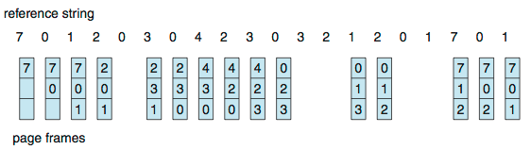
First-In-First-Out (FIFO) Algorithm
Reference string: 7,0,1,2,0,3,0,4,2,3,0,3,0,3,2,1,2,0,1,7,0,1
3 frames (3 pages can be in memory at a time per process)
Can vary by reference string: consider 1,2,3,4,1,2,5,1,2,3,4,5
Adding more frames can cause more page faults!
How to track ages of pages?
Just use a FIFO queue
15 page faults

Slide 20
Optimal Algorithm
Replace the page that will not be used for the longest period of time is called principal of locality
This algorithm guarantees the lowest possible page fault rate
Salient points
Optimal replacement is much better than FIFO
Difficult to implement, since it requires future knowledge of reference string
Not used in practical systems because it cannot implement
Optimal algorithm is mainly used for comparison studies

Slide 21
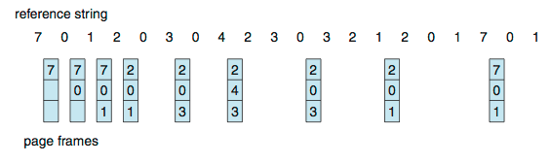
Optimal Algorithm
Replace page that will not be used for longest period of time
9 is optimal for the example
How do you know this?
Can’t read the future
Used for measuring how well your algorithm performs
9 page faults

Slide 22
Least Recently Used (LRU) Algorithm
Least recently used (LRU) algorithm chooses that page that has not been used for the longest period of time
Salient points
LRU is quite good
Not easy to implement, the problem is to determine an order for the frames defined by the time of last use
Requires substantial hardware assistance because of tremendous overheads due to interrupts
LRU feasible as a stack
Keep a stack of page numbers
Whenever a page is referenced, it is removed from the stack and put on top
In this way the top of the stack contains MRU page and bottom LRU page

Slide 23
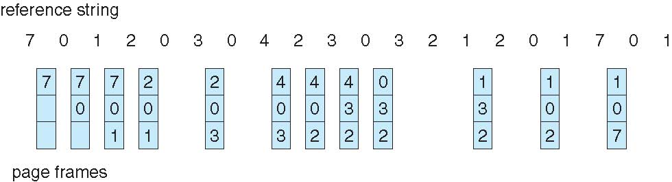
Least Recently Used (LRU) Algorithm
Use past knowledge rather than future
Replace page that has not been used in the most amount of time
Associate time of last use with each page
12 faults – better than FIFO but worse than OPT
Generally good algorithm and frequently used
But how to implement?
12 page faults

Slide 24
Least Frequently Used (LFU) Algorithm
LFU page replacement algorithm replaces the page from memory which is least frequently used
It keeps a counter for the number of references to each page and the page with the smallest count is replaced
This algorithm suffers from the situation in which a page initially used heavily, but then never again used

Slide 25
Least Recently Used (LRU) Algorithm – Example
Given
Number of Page Frames = 3
Reference String: 7 0 1 2 0 3 0 4 2 3 0 3 2
Reference: 7 0 1 2 0 3 0 4 2 3 0 3 2
------------------------------------------------
Frame 1: 7 7 7 2 2 2 2 4 4 4 0 0 0
Frame 2: - 0 0 0 0 0 0 0 0 3 3 3 3
Frame 3: - - 1 1 1 3 3 3 2 2 2 2 2
------------------------------------------------
Page Faults: ✔ ✔ ✔ ✔ ✘ ✔ ✘ ✔ ✔ ✔ ✔ ✘ ✘
Total Page Faults = 9 Page Faults

Slide 26
Most Frequently Used (MFU) Algorithm
MFU page replacement algorithm replaces the page from memory which is most frequently used
It is based on the argument that the page with the smallest count was probably just brought in and has yet to be used
Its implementation is expensive
Neither MFU nor LFU replacement algorithm is common

Slide 27
MFU – Example
Given
Number of Page Frames = 3
Reference String: 1 2 3 2 4 1 5 2 1 2 3 4
Reference: 1 2 3 2 4 1 5 2 1 2 3 4
------------------------------------------------
Frame 1: 1 1 1 1 4 4 5 5 5 5 3 3
Frame 2: - 2 2 2 2 1 1 2 2 2 2 4
Frame 3: - - 3 3 3 3 3 3 1 1 1 1
------------------------------------------------
Page Faults: ✔ ✔ ✔ ✘ ✔ ✔ ✔ ✔ ✔ ✘ ✔ ✔
Total Page Faults (MFU)
10 Page Faults

